Slide 1
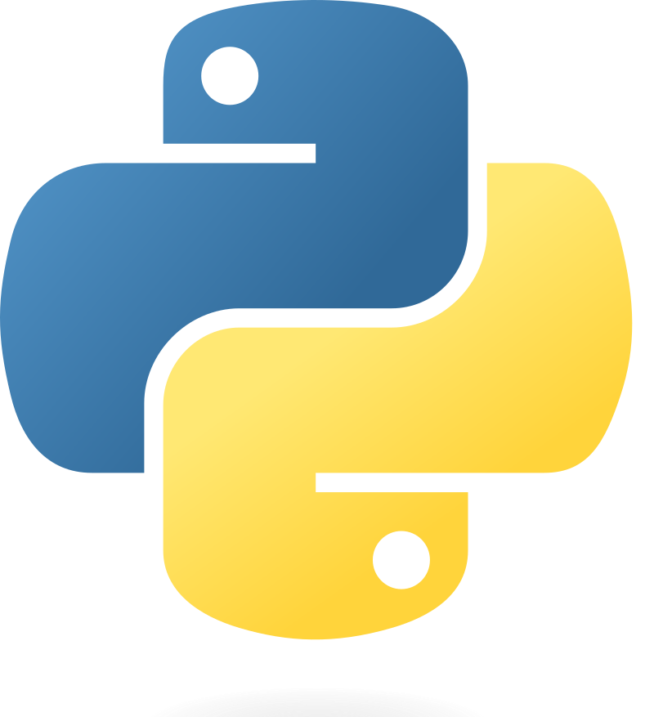
Part 1 – Software Prerequisites for Python Projects
Quang Duong

Slide 2
Software Prerequisites for Python Projects

Slide 3


Software Prerequisites for Python Projects
1.
IDE
VS Code, PyCharm, …
Including
A source code editor,
Build automation tools,
A debugger,
Code completion,
Syntax highlighting,
Version control integration, etc
Allowing developers to
Write, compile, test, and debug their code within a single interface
Popular IDEs
VS Code, PyCharm, Eclipse, etc

Slide 4

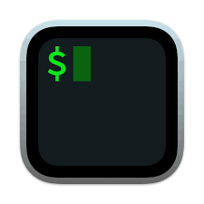
Software Prerequisites for Python Projects
1.
IDE
VS Code, PyCharm, …
2.
Terminal
PowerShell (Windows), iTerm2(Mac OS), …
Used for
Command execution
File manipulation,
Program execution,
System administration tasks
Popular terminal applications
Windows: Command Prompt, PowerShell
Linux: Bash
macOS: iTerm2

Slide 5

Software Prerequisites for Python Projects
1.
IDE
VS Code, PyCharm, …
2.
Terminal
PowerShell (Windows), iTerm2(Mac OS), …
Created by Guido van Rossum and first released in 1991
A high-level, interpreted programming language
Simplicity
Readability
Supports multiple programming paradigms
Procedural,
Object-oriented,
Functional programming.
Extensive standard library
Active community contribute to a vast ecosystem of frameworks and tools
3.
Python
Installing via: Python installer, Anaconda distributions

Slide 6
Software Prerequisites for Python Projects
1.
IDE
VS Code, PyCharm, …
2.
Terminal
PowerShell (Windows), iTerm2(Mac OS), …
3.
Python
Installing via: Python installer, Anaconda distributions
A setup where Python and its related tools and libraries are installed and configured
To develop and
Run Python applications
Popular ways to create Python environment
Virtual Environment
Using venv or virtualenv
Conda Environment
Using conda
IDE tools like PyCharm, VS Code
4.
Python environment
`venv `, `conda`

Slide 7
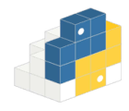
Software Prerequisites for Python Projects
1.
IDE
VS Code, PyCharm, …
2.
Terminal
PowerShell (Windows), iTerm2(Mac OS), …
3.
Python
Installing via: Python installer, Anaconda distributions
Collections of modules and functions that extend the capabilities of the Python programming language
To reuse code
To implement complex functionality without having to write it from scratch
Python Package Manager
pip, conda
4.
Python environment
`venv `, `conda`
5.
Python Packages
Pypi, Anaconda

Slide 8
Integrated Development Environment (IDE)

Slide 9
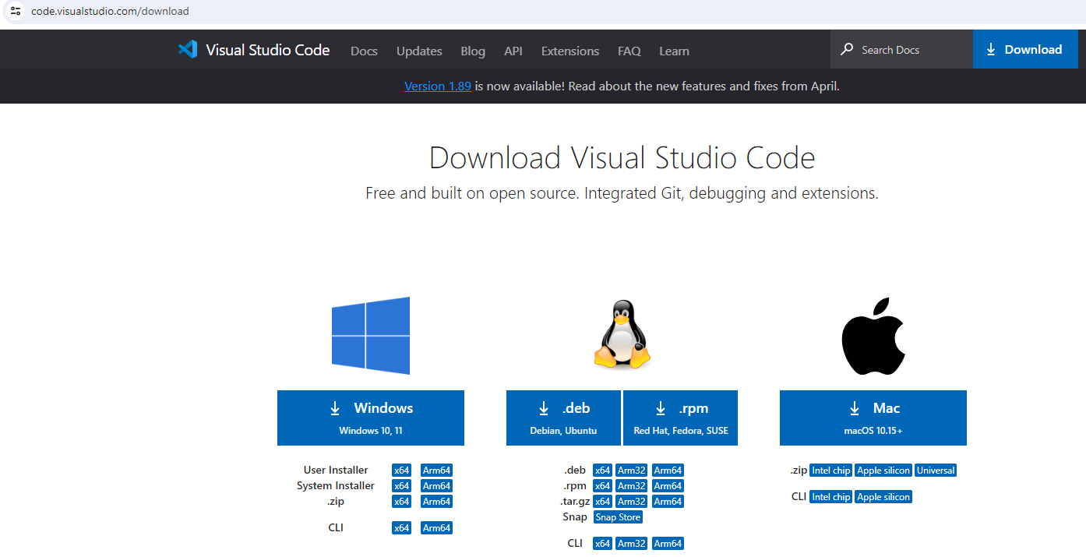
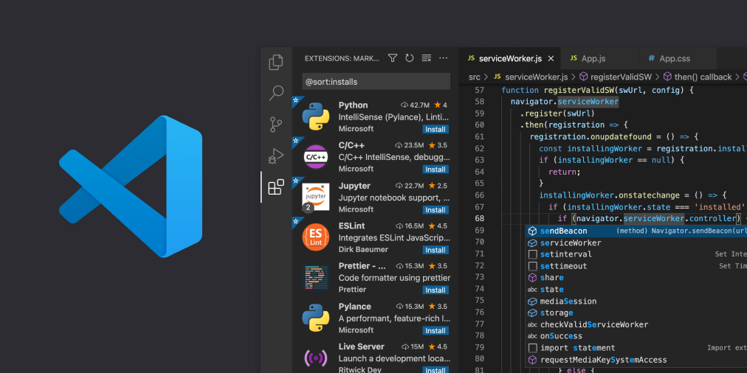
IDE
VS Code (https://code.visualstudio.com/download)

Slide 10
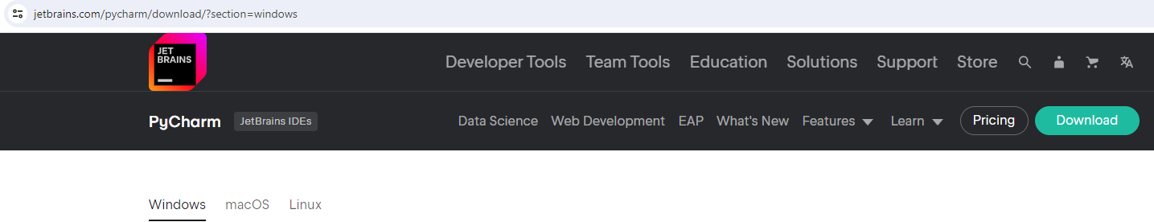
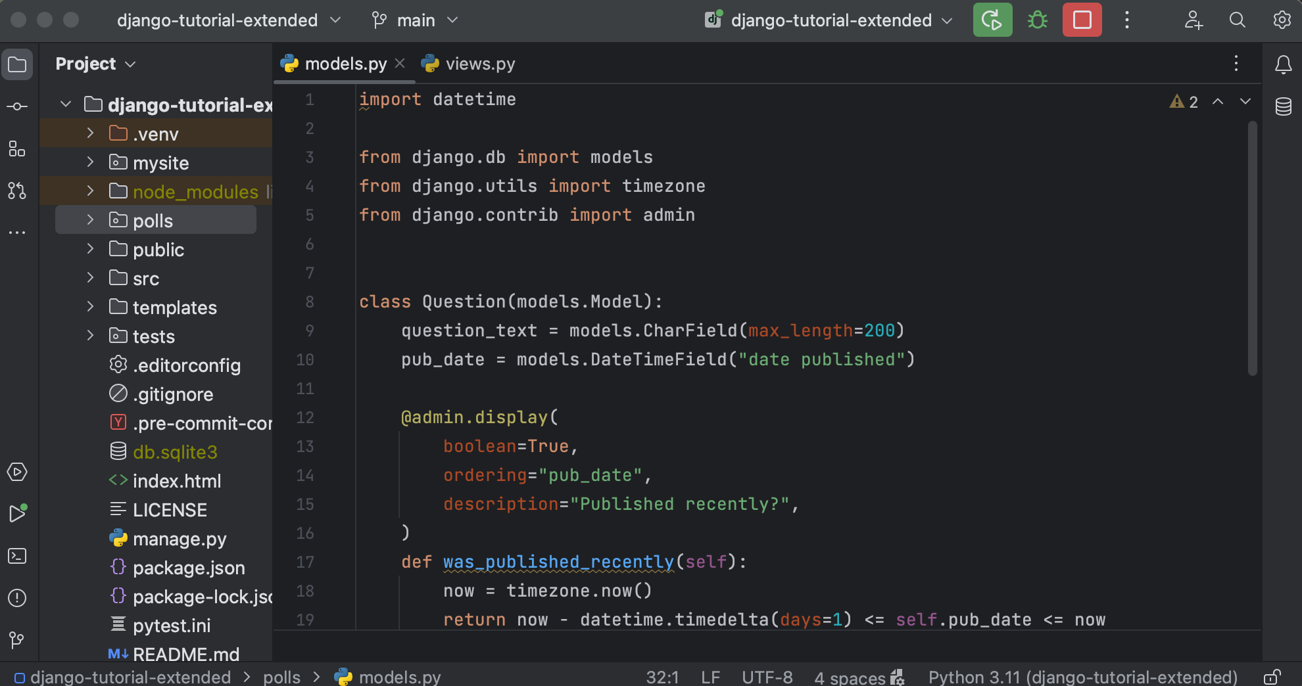

IDE
PyCharm (https://www.jetbrains.com/pycharm/download/?section=windows)

Slide 11
Terminal

Slide 12
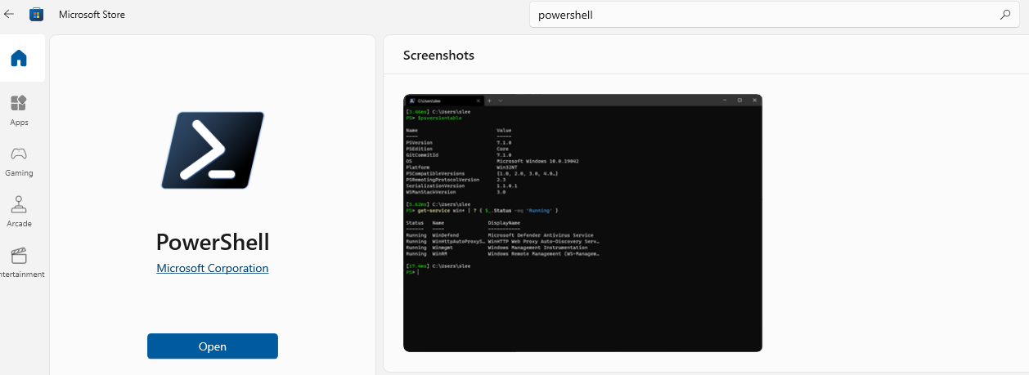
Terminal
Window: PowerShell, Command Prompt, Windows Terminal, Git Bash, WSL (Window Subsystem for Linux), …

Slide 13
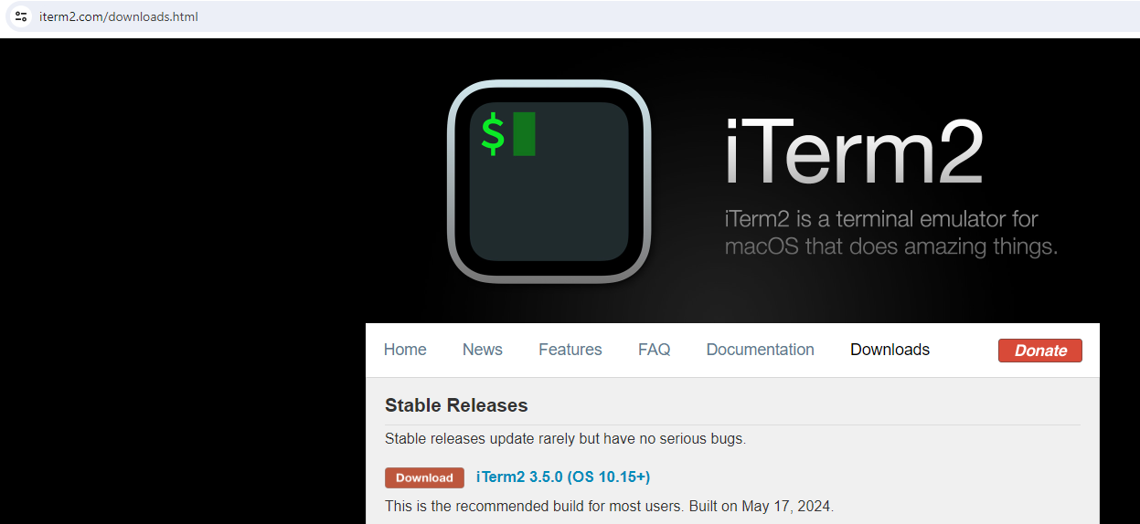
Terminal
Linux: Default terminal emulator, …
MacOS: Terminal, iTerm2 (https://iterm2.com/downloads.html), …

Slide 14
Python Installation

Slide 15
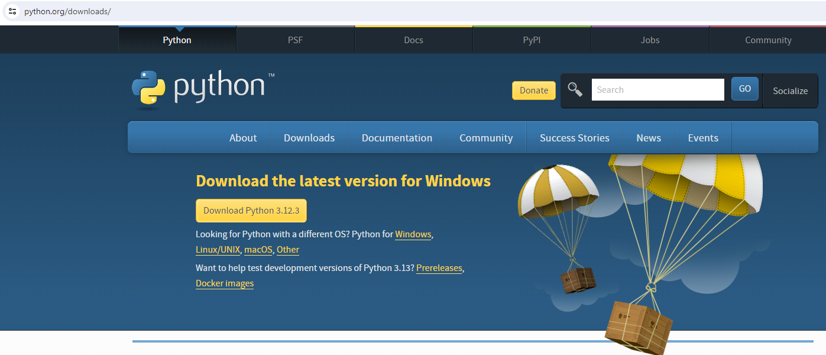
Python Installation
https://www.python.org/downloads/

Slide 16
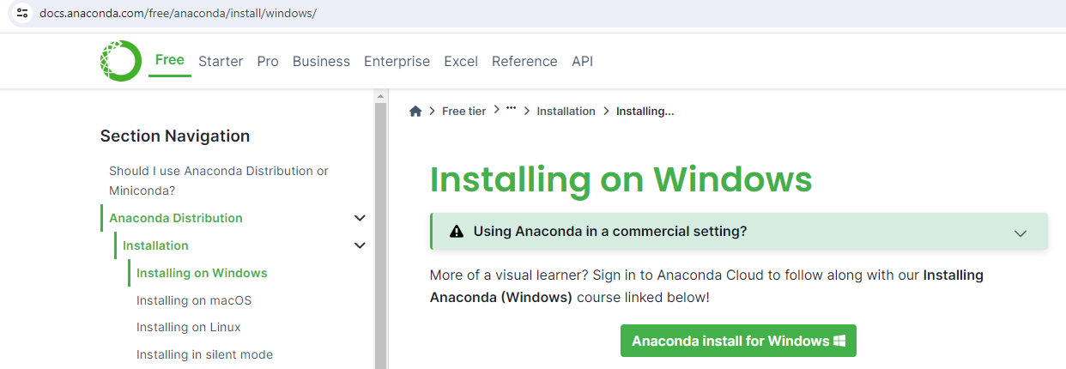
Python Installation
Installing Anaconda with Python included (https://docs.anaconda.com/free/anaconda/install/)

Slide 17
Python Environment

Slide 18
Python environment
Using ` venv `, a module included in Python 3.3 & later versions
# Create Python environment with `venv`
# Navigate into the project directory
cd path/to/your/project # Create Python environment, eg. named ".myenv"
python -m venv .myenv
# (For Linux, MacOS, you may need to use `python3` instead of `python`)
# Activate ".myenv" environment
.myenv\Scripts\activate # For Window
source myenv/bin/activate # For Linux, MacOS
# Install required Python packages and start working. (Next slides)
# Deactivate ".myenv" environment after finishing the dev
deactivate

Slide 19
Python environment
Using `conda`
# Create Python environment with `conda`, eg. named "myenv"
conda create -n myenv python=3.10
# Activate "myenv" environment
conda activate myenv
# Install required Python packages and start working. (Next slides)
# Deactivate "myenv" environment after finishing the dev
conda deactivate

Slide 20
Python Package Installation

Slide 21
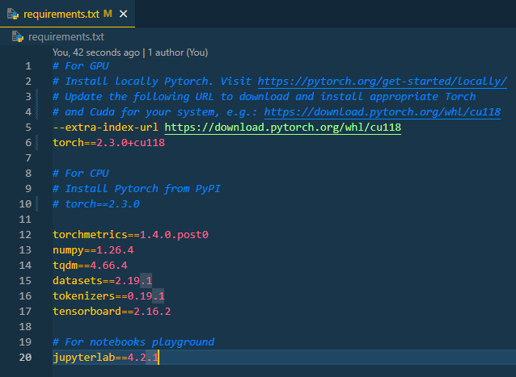
Python Package Installation
Activating Python environment
Using `pip` inside either venv or conda environment
Installing a Python package
`pip install package_name==version`
E.g. `pip install torch==2.3.0`
Installing all required packages in "requirements.txt"
`pip install –r requirements.txt`

Slide 22
Pieces of Software Used in This Course

Slide 23
Pieces of Software Used in This Course
IDE:
VS Code
Terminal (Windows)
PowerShell
For Python & Python Environment
conda (Anaconda)
For Python Package Installation
pip
conda create -n ENV_NAME python=3.10 conda activate ENV_NAME
pip install –r requirements.txt

